Slide 1

Lovely dating
New Platform

Slide 2

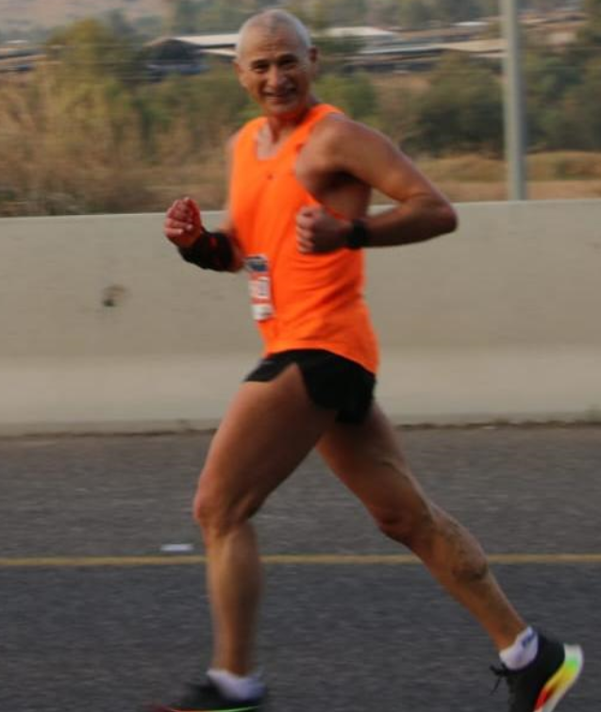
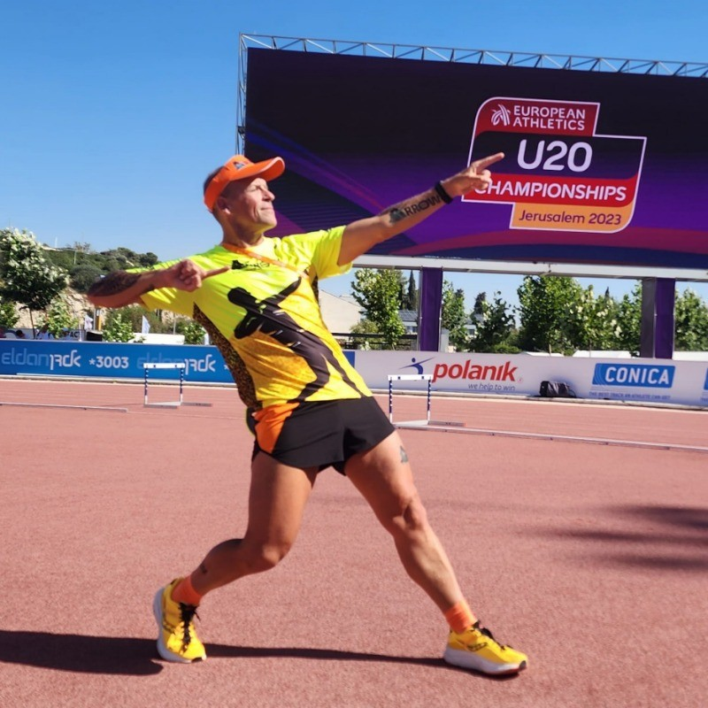
Clouding4U
Ron Malachi
Our Team
Yuval Hets
CISO, Project Manager

Slide 3

Requirements’ status
Completed
Alternatives
Open

Slide 4
Lovely dating
HLD

Slide 5
Lovely dating
LLD

Slide 6
Thank You

